Slide 1
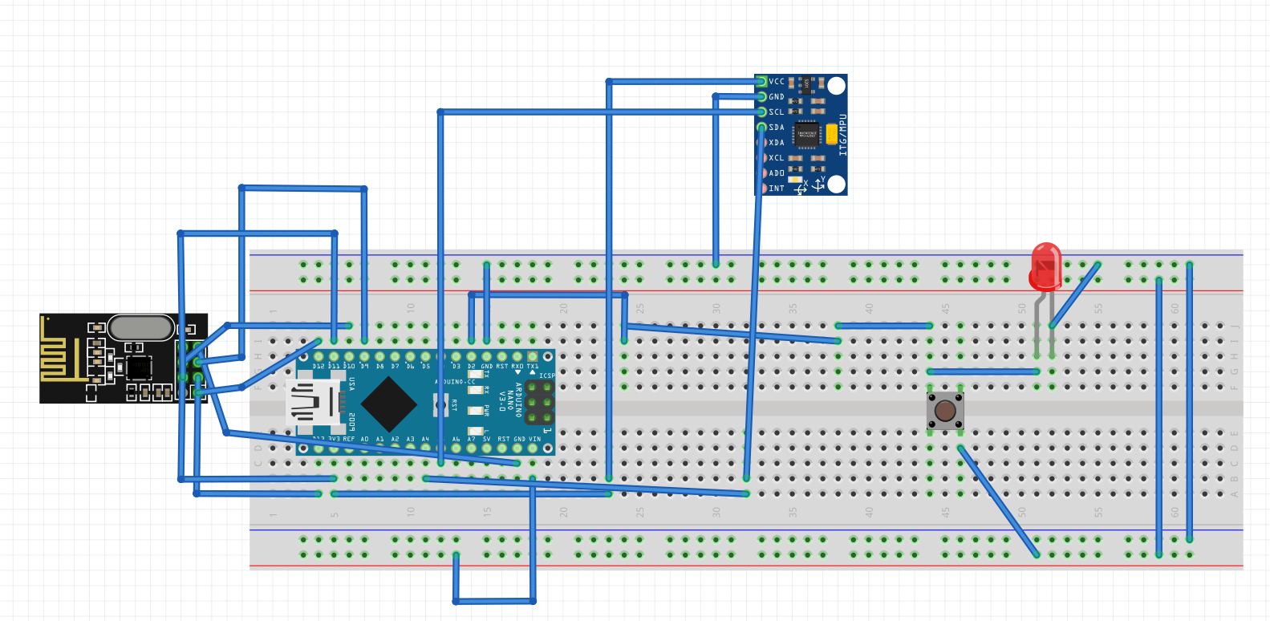
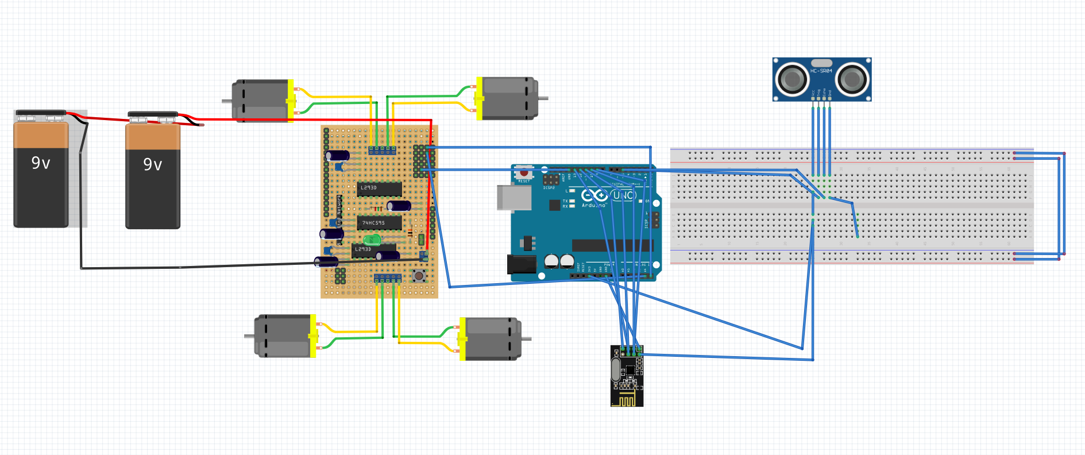
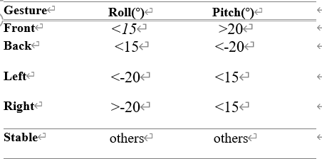
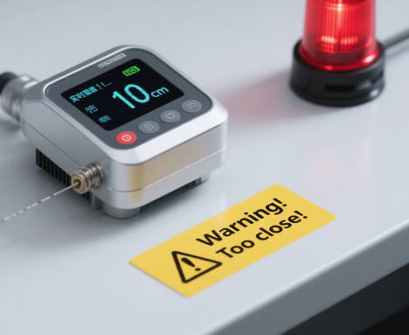
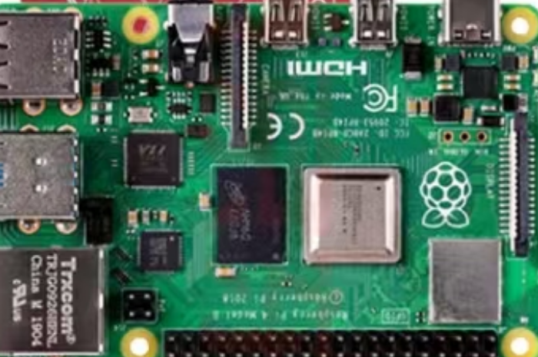


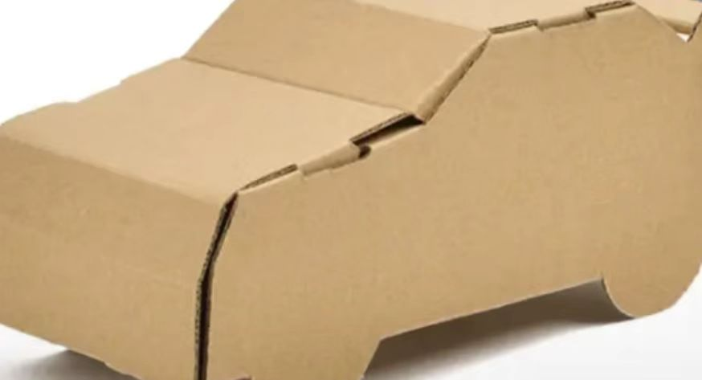
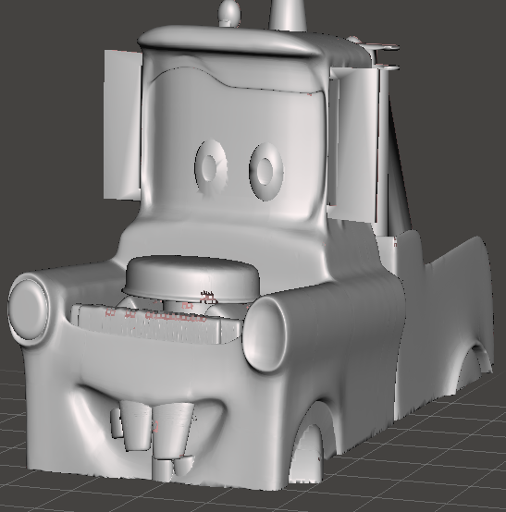
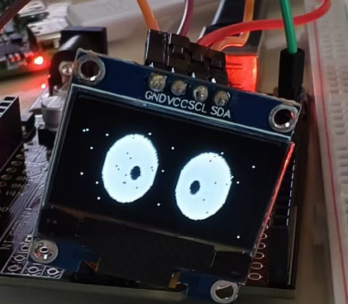
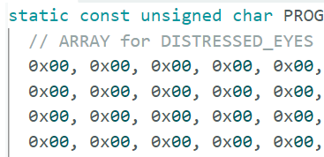
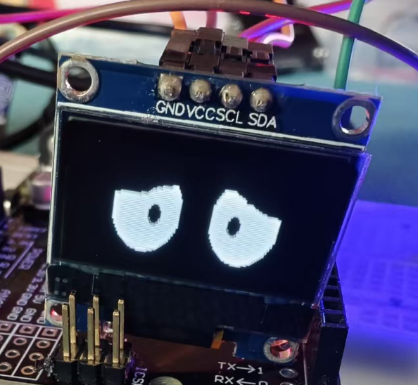
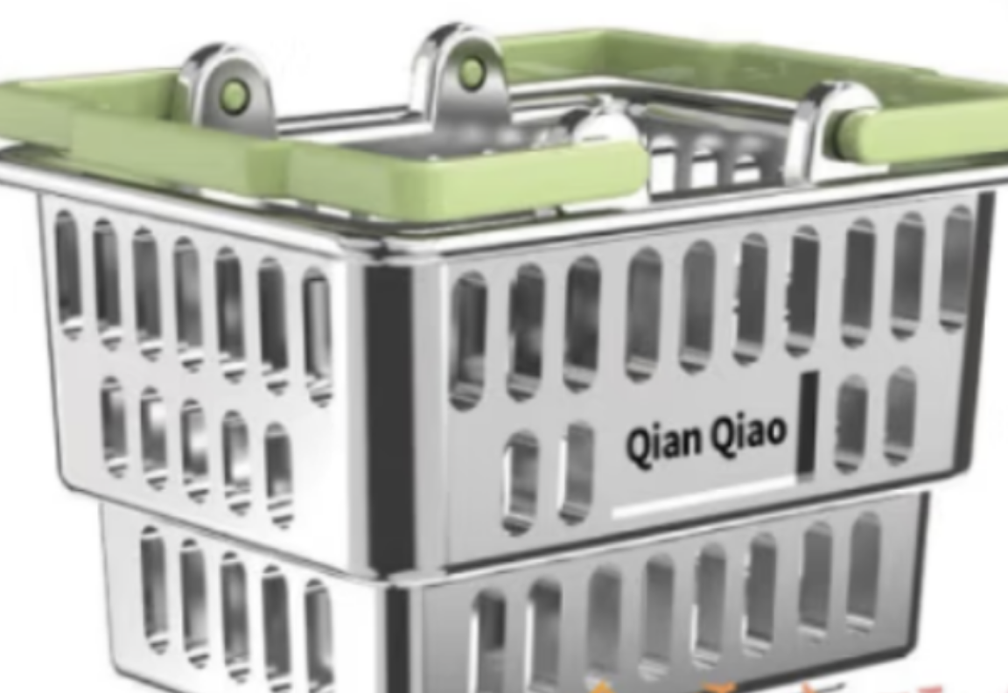




A Smart Shopping Cart with Gesture and
Vision-Based Tracking System
Department of Electrical and Electronic Engineering, Xi'an Jiaotong-Liverpool University
Supervisor: Quan Zhang, Martijn ten Bhömer, Jie Sun, Rui Pei
Group members: Hengzhi Qiu, Suheng Ji, Yukun Zheng, Yaoran Xu
SURF-2024-0384
Abstract: In this project., we have designed a smart shopping cart which has various functions. In this poster, it is divided into seven sections including user needs and design requirements, design features, contribution, hardware and software function implementation, user testing and feedback, conclusion and future improvement,
User needs and design requirement1.
Hardware and Software implementation
---- A questionnaire survey
Traditional shopping mart is inconvenient for elderly people to push.
Simple, natural, and interesting human-computer interaction needs.
Satisfy various complex environments encountered during the shopping process.
---- Design requirement
Two modes including automatic following mode and gesture control mode.
Interact with the shopping mart.
Obstacle Detection and Security Alarm Mechanism.
---- Hardware function ---- Software function
Gesture recognition algorithm function
Figure 1. Circuit diagram of the three different layers
Sensor recognition layer: Implement user gesture information collection and convert it into control instructions to be transmitted to the shopping cart.
Control logic layer: Complete instruction processing, implement motion instruction, and ensure accurate communication of instructions.
Obstacle avoidance algorithm function
Execution driver layer: receives upper-level instructions, drives the motor, and implements motion control of the shopping cart.
Design features
Raspberry pi 4 Model B,(visual recognition and system perception capability)
Hierarchical design: sending layer, control logic layer, and execution driver layer for gesture control
---- Decorative materials
Automatic tracking: achieved through ultrasonic sensors for automatic tracking and obstacle avoidance detection.
System recognition capability (Member user identification): Updating OLED Screen with Raspberry Pi 4 for QR Code Recognition.
Figure 4. Pictures of the decorative materials
User experience related functions (OLED and sound module)
Humanize the design through OLED, simple gesture control, and various decorative materials.
User testing and feedback
Contribution
Student Niu says: The project has rich functions, which can effectively free the hands of the elderly and also has a certain level of fun.
Name | Workload
Hengzhi Qiu (25%) | Assembly of the main circuit and each module of the gesture-controlled car; Help with the construction of the gesture-controlled car code; Write a part of the report. PPT design.
Suheng Ji (25%) | Build a 3D model of the exterior shell for the gesture-driven car; Assembling OLED for the gesture-controlled car; Shoot a video of the gesture-controlled car; Write a part of the report. Poster Design.
Yukun Zheng (25%) | Assign tasks to each link in the process; Write the codes for each module of the gesture-controlled car; Assist in the installation of the gesture-controlled car; Write a part of the report. PPT Design.
Yaoran Xu (25%) | Editing and production of the video of the gesture-controlled car; Help connect the circuits of some modules of the gesture-controlled car; Write a part of the report. Poster Design.
Student Sun says: It can be done more accurately, such as the tracking function being more intelligent and responsive, and the integrated functions being richer.
Conclusion
Future Improvement
Shopping cart with integrated functions.
Convenient for the elderly and improve the experience.
Stable, user-friendly and interesting human-computer interaction.
Gesture recognition accuracy..
Richer human-computer interaction functions.
System delay optimization and more stable system.
:
Reference:
[1] L. Ji-Herr, U. K. Rosli, L. T. Chuan, S. C. Sen, and L. Y. Xia, "Revolution of Retail Industry: From Perspective of Retail 1.0 to 4.0," in *Procedia Computer Science*, vol. 202, pp. 353-359, 2022. doi: 10.1016/j.procs.2022.01.052.
[2] Y. Mercan, K. T. Selcuk, and A. A. Sayilan, "The relationship between types of physical disabilities and the Instrumental Activities of Daily Living (IADL) in the elderly," *Family Medicine & Primary Care Review*, vol. 23, no. 1, pp. 22-28, 2021. doi: 10.5114/fmpcr.2021.103153.

